Slide 1



Unlocking the power of
&
Notes:
Point is that I want people to shift their mindset a little bit to better understand the problems they encounter
I’d assume that people have used these libraries before, but please call me out on concepts you don’t understand or something I’ve said but not explained, because I’ve spent 3 days looking at this stuff and I might think I said something but didn’t

Slide 2
Welcome to the ACCESS Training Day 2025!
9th September 2025

Slide 3

Acknowledgement of Country
We at ACCESS-NRI acknowledge the Traditional Owners of the land on which our research infrastructure and community operate across Australia and pay our respects to Elders past and present. We recognise the thousands of years of accumulated knowledge and deep connection they have with all the Earth systems we simulate.
Today we are meeting on the lands of the Wurundjeri Woi-Wurrung people.

Slide 4
Wifi
WiFi Network: MelbConnectGuest or Eduroam

Slide 5
Housekeeping
Toilets behind the registration desk
Refreshment breaks:
Tea and coffee between Forum 3 and the meeting rooms
Food at The Lab (walk past the café and turn left)
Emergency Exits
Front of the building near the main stairs.
Back of the building past the meeting rooms.
Follow instructions from Melbourne Connect staff.
ACCESS-NRI staff will take photos during this event
To opt out, see the registration desk.
Covid Safe Plan: https://www.access-nri.org.au/wp-content/uploads/2022/12/COVID-Safe-page-December-2022.pdf
We want everyone to feel safe and respected. If you experience or witness anything concerning, feel free to contact Paige Martin (paige.martin@anu.edu.au) or Jasmeen Kaur (jasmeen.kaur@anu.edu.au) and we'll make sure it is handled confidentially.

Slide 6



Training Day Materials and Setup Requirements
https://docs.access-hive.org.au/community_resources/access_workshop_2025/
Scan me!

Slide 7
Unlocking the power of
&
Notes:
Point is that I want people to shift their mindset a little bit to better understand the problems they encounter
I’d assume that people have used these libraries before, but please call me out on concepts you don’t understand or something I’ve said but not explained, because I’ve spent 3 days looking at this stuff and I might think I said something but didn’t

Slide 8



Why bother writing good code?
Save time
Do more
Make something work at all
Notes:
has a good figure

Slide 9

Aims
To learn principles of good code, and get in the habit of thinking about what your code is doing
To understand vectorizing, xarray, and dask
To be able to:
Rewrite complicated ideas into vectorized code
Use dask to make this code run faster with less memory
To further optimize dask code with a few key arguments and the structure of your algorithm

Slide 10




Aims
To learn principles of good code, and get in the habit of thinking about what your code is doing
To understand vectorizing, xarray, and dask
To be able to:
Rewrite complicated ideas into vectorized code
Use dask to make this code run faster with less memory
To further optimize dask code with a few key arguments and the structure of your algorithm

Slide 11
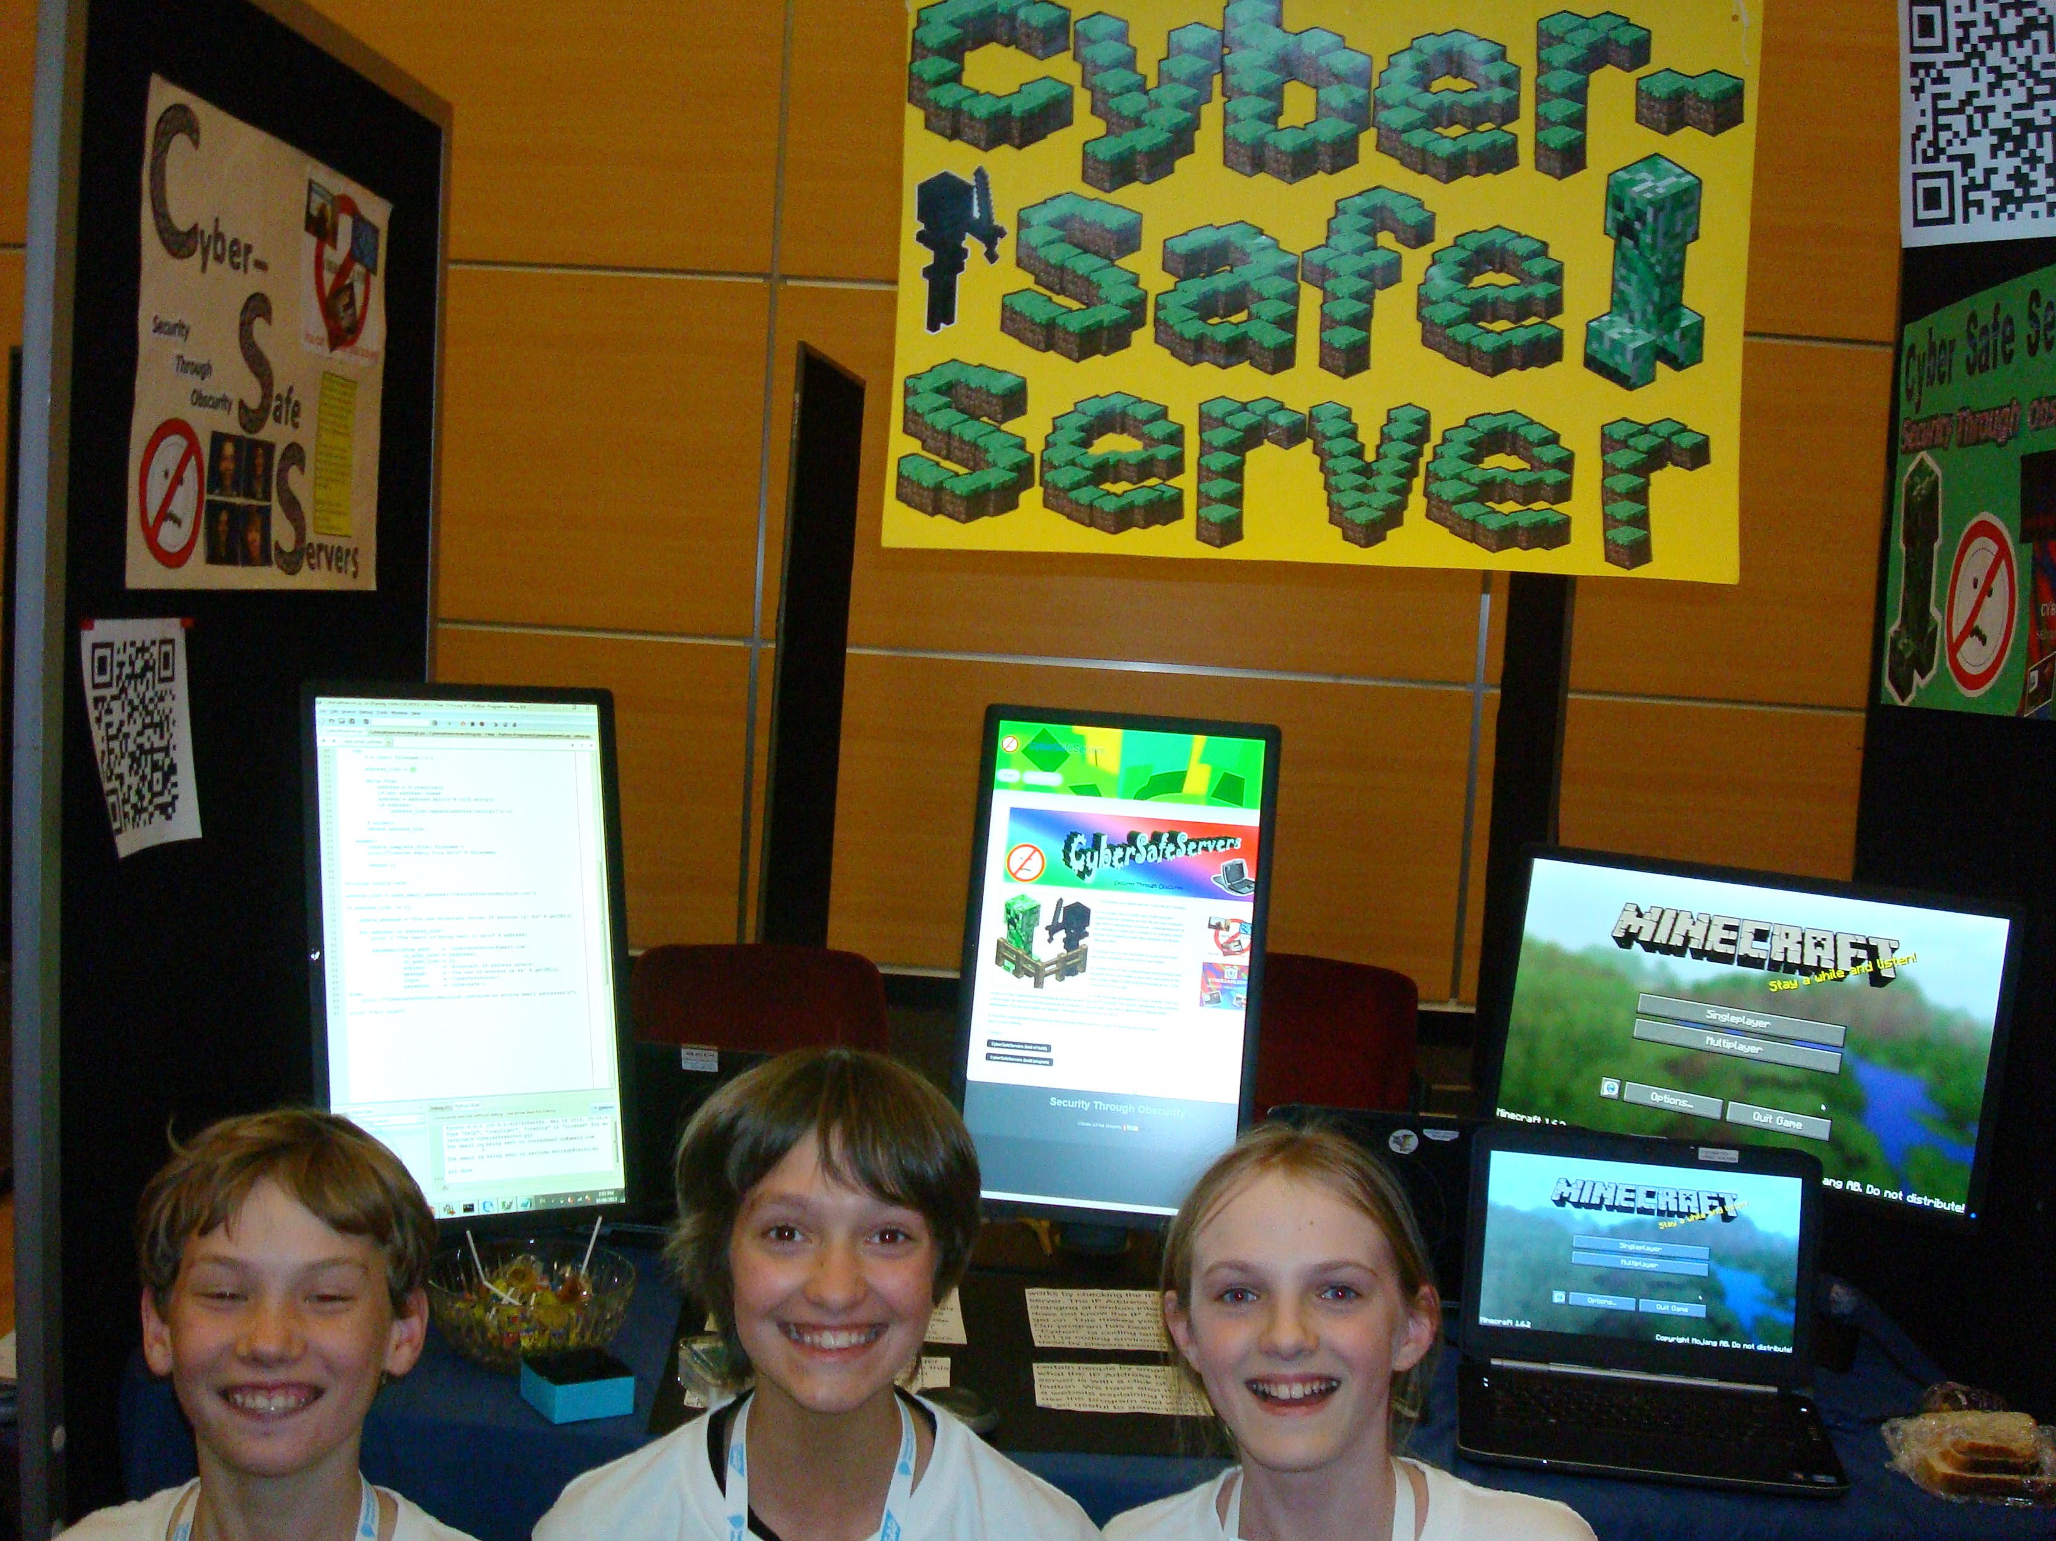
3 key moments in my journey
Young ICT explorers (grade 6)
Notes:
Most of you know me. Possibly not my background here.
Learned to code in primary school (cyber safe servers)
(ended up later teaching code to primary school students as a job during high school)
Australian informatics school of excellence

Slide 12
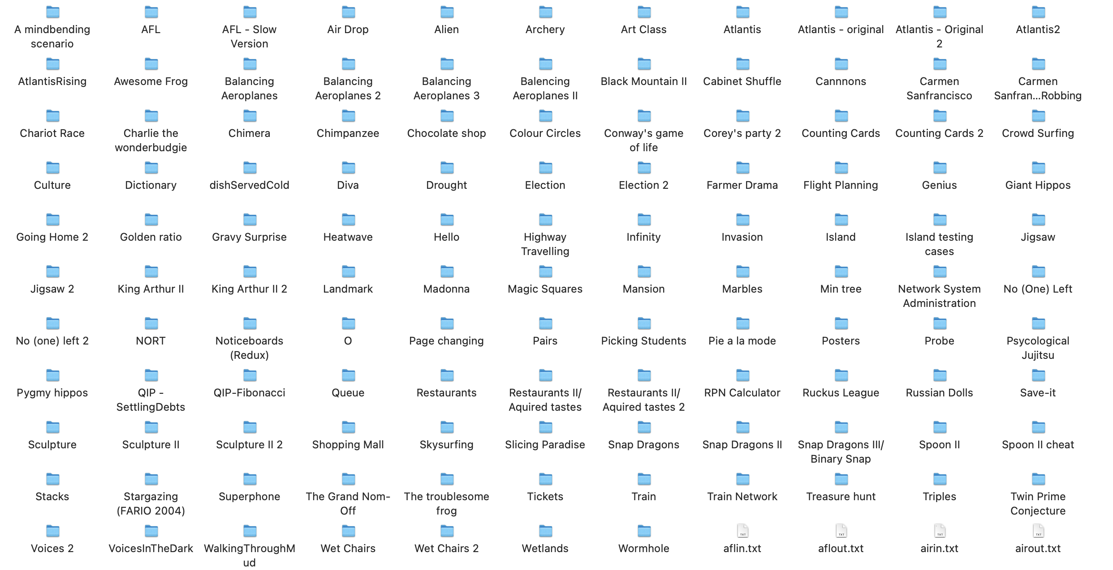
3 key moments in my journey
Young ICT explorers (grade 6)
Australian Informatics summer school (grade 11)
Notes:
Most of you know me. Possibly not my background here.
Learned to code in primary school (cyber safe servers)
(ended up later teaching code to primary school students as a job during high school)
Australian informatics school of excellence

Slide 13
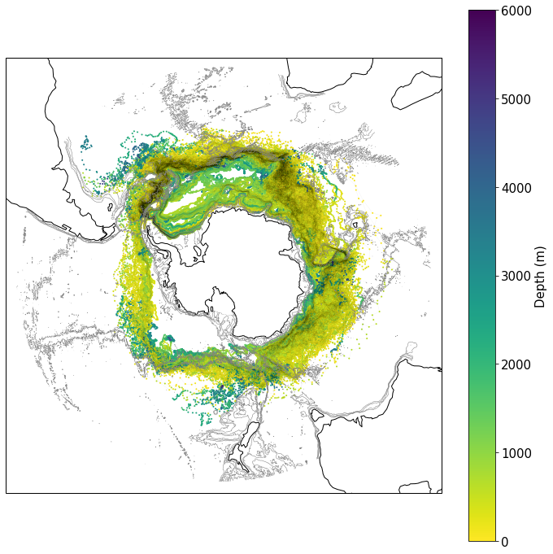
3 key moments in my journey
Young ICT explorers (grade 6)
Australian Informatics summer school (grade 11)
AABW project in undergraduate (2nd year)
Notes:
NOTE also my first forays into xarray source code in the last couple years. Surprisingly well documented, but also weird.
So the argument I would like to make here

Slide 14
Notes:
NOTE also my first forays into xarray source code in the last couple years. Surprisingly well documented, but also weird.
So the argument I would like to make here

Slide 15



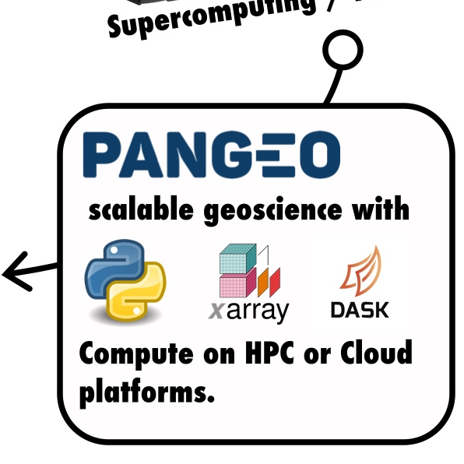
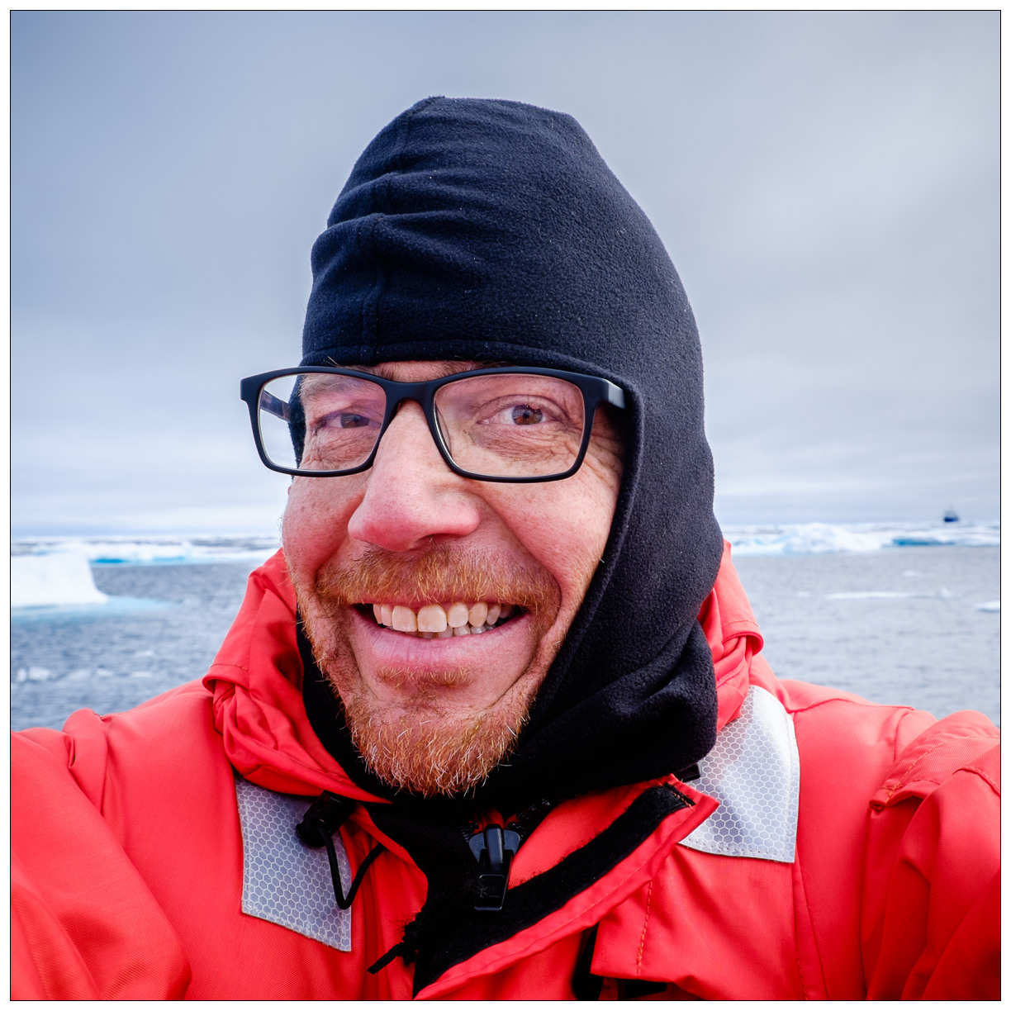
Thomas Moore
Ocean Dynamics Team Lead
CSIRO
way back then:
deploying ocean sensors on remote Indonesian reefs
back then:
communicating ocean science in the Arctic
now:
ocean data science on Australia’s super computers

Slide 16



Introduce yourself to your table:
What is your science background?
What is your coding background?
What do you hope to gain from this morning?
Notes:
Might want to work through exercises in future within these groups, or on your own, whatever works best
*** ASK FOR SUMMARIES FROM PEOPLE ***

Slide 17
Aims
To learn principles of good code, and get in the habit of thinking about what your code is doing
To understand vectorizing, xarray, and dask
To be able to:
Rewrite complicated ideas into vectorized code
Use dask to make this code run faster with less memory
To further optimize dask code with a few key arguments and the structure of your algorithm

Slide 18
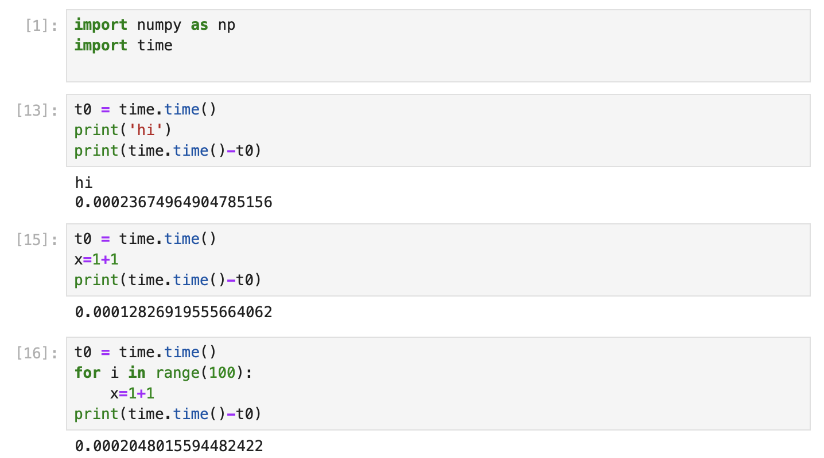
Timing examples whatisfastcode.ipynb
git clone git@github.com:jemmajeffree/ACCESS-2025-xarray-dask-training.git
Notes:
I think the key point of this slide is that ENSO behaviour appears to change.
Maybe talk about diversity in here?
Lump everything together for decadal changes bc there’s evidence they’re the same.
I think the graphic to use is ENSO predictability changes. Check if Barnston 2012 or Meinen/McPhaden about the same time has a good figure

Slide 19
Aims
To learn principles of good code, and get in the habit of thinking about what your code is doing
To understand vectorizing, xarray, and dask
To be able to:
Rewrite complicated ideas into vectorized code
Use dask to make this code run faster with less memory
To further optimize dask code with a few key arguments and the structure of your algorithm

Slide 20
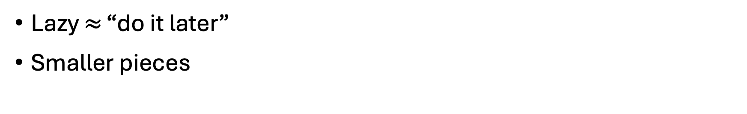
Lazy computing
Lazy $≈$ “do it later”
Smaller pieces
Example: summing in different chunks
1 | 5 | 3 | 7 | 8 | 2 | 4 | 6 | 9
45
8 | 17 | 19
45
Notes:
Advantage: memory, and spreading out work
Some of these examples are going to be doing simple things a slightly odd way, because I think they make better examples than the complicated problems
Dask often does an okay job of doing things in the right order, but I think subsetting is still better earlier?
And this is why you’re limited to a set vocab

Slide 21
Lazy computing
Lazy $≈$ “do it later”
Smaller pieces
Example: finding maximum in different chunks
1 | 5 | 3 | 7 | 8 | 2 | 4 | 6 | 9
9
5 | 8 | 9
9
Notes:
Advantage: memory, and spreading out work
Some of these examples are going to be doing simple things a slightly odd way, because I think they make better examples than the complicated problems
Dask often does an okay job of doing things in the right order, but I think subsetting is still better earlier?
And this is why you’re limited to a set vocab

Slide 22
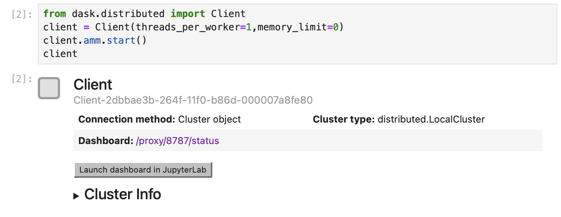
whatisxarraydask.ipynb
Notes:
Advantage: memory, and spreading out work
Some of these examples are going to be doing simple things a slightly odd way, because I think they make better examples than the complicated problems
Dask often does an okay job of doing things in the right order, but I think subsetting is still better earlier?
And this is why you’re limited to a set vocab

Slide 23
Chunking activity - IRL!
Chunking activity - IRL!

Slide 24

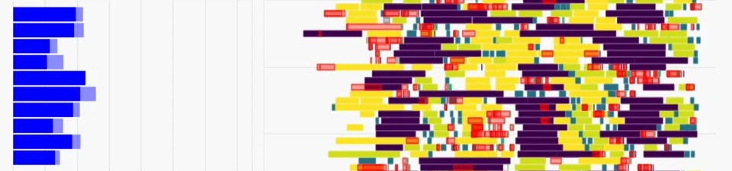
Chunking activity - IRL!
We are all going to be Dask workers or schedulers!

Slide 25
Chunking activity - IRL!
We are all going to be Dask workers or schedulers!
Computation: each group will sum 50 numbers (generated randomly, between 1 and 100)

Slide 26
Chunking activity - IRL!
We are all going to be Dask workers or schedulers!
Computation: each group will sum 50 numbers (generated randomly, between 1 and 100)
Workers:
Sum numbers
Can only talk with the scheduler
Cannot communicate with any other workers

Slide 27
Chunking activity - IRL!
We are all going to be Dask workers or schedulers!
Computation: each group will sum 50 numbers (generated randomly, between 1 and 100)
Workers:
Sum numbers
Can only talk with the scheduler
Cannot communicate with any other workers
Schedulers:
Communicates with the workers
Directs the workers such that they can find the total sum

Slide 28
Chunking activity - IRL!
We are all going to be Dask workers or schedulers!
Computation: each group will sum 50 numbers (generated randomly, between 1 and 100)
Workers:
Sum numbers
Can only talk with the scheduler
Cannot communicate with any other workers
Schedulers:
Communicates with the workers
Directs the workers such that they can find the total sum
Group 1
1 🙍
1 chunk, length 50

Slide 29
Chunking activity - IRL!
We are all going to be Dask workers or schedulers!
Computation: each group will sum 50 numbers (generated randomly, between 1 and 100)
Workers:
Sum numbers
Can only talk with the scheduler
Cannot communicate with any other workers
Schedulers:
Communicates with the workers
Directs the workers such that they can find the total sum
Group 1
Group 2
1 🙍
6 🙍
1 scheduler + 5 workers
1 chunk, length 50
5 chunks, length 10

Slide 30
Chunking activity - IRL!
We are all going to be Dask workers or schedulers!
Computation: each group will sum 50 numbers (generated randomly, between 1 and 100)
Workers:
Sum numbers
Can only talk with the scheduler
Cannot communicate with any other workers
Schedulers:
Communicates with the workers
Directs the workers such that they can find the total sum
Group 1
Group 2
Group 3
1 🙍
6 🙍
1 scheduler + 5 workers
Everyone else 🙍
1 scheduler + many workers
1 chunk, length 50
5 chunks, length 10
25 chunks, length 2

Slide 31


The black magic of chunking
Match the chunks on file
Either chunk when opening or after loading
Double check your assumptions
Test in small batches
Keep the task stream open

Slide 32
chunking.ipynb
Notes:
Advantage: memory, and spreading out work
Some of these examples are going to be doing simple things a slightly odd way, because I think they make better examples than the complicated problems
Dask often does an okay job of doing things in the right order, but I think subsetting is still better earlier?
And this is why you’re limited to a set vocab

Slide 34
Recap of key points
What does fast/good code mean?
How can xarray/dask help?
Example: summing in different chunks
1 | 5 | 3 | 7 | 8 | 2 | 4 | 6 | 9
45
8 | 17 | 19
45
Notes:
I think the key point of this slide is that ENSO behaviour appears to change.
Maybe talk about diversity in here?
Lump everything together for decadal changes bc there’s evidence they’re the same.
I think the graphic to use is ENSO predictability changes. Check if Barnston 2012 or Meinen/McPhaden about the same time has a good figure

Slide 35




But what if I want to do more than just sum?
Writing code to work well with xarray and dask is a completely different way of thinking
Notes:
I think the key point of this slide is that ENSO behaviour appears to change.
Maybe talk about diversity in here?
Lump everything together for decadal changes bc there’s evidence they’re the same.
I think the graphic to use is ENSO predictability changes. Check if Barnston 2012 or Meinen/McPhaden about the same time has a good figure

Slide 36


Rethinking code: your tools
Can you break your problem into these pieces?
Any maths (*, +, np.log(), ds.cumsum(), …)
Dimension reduction by maths (ds.sum(), ds.std(), …)
Dimension reduction by picking one (ds.max(), ds.argmin(),ds.sel(), …)
Moving stuff (ds.shift(), ds.coarsen(), …)
Grabbing strange pieces (ds.where(), ds.groupby(), …)
√x | √x | √x | √x | √x
√x | √x | √x | √x | √x
√x | √x | √x | √x | √x
Full list here: https://docs.xarray.dev/en/stable/generated/xarray.DataArray.html

Slide 37
Rethinking code: examples
NINO34 index
Weighted rolling average
20°C isotherm
Model analogue forecasts

Slide 38
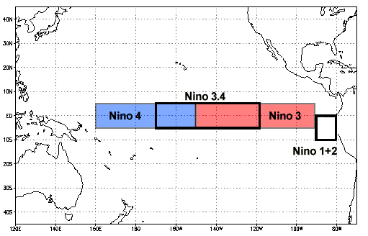

Example 1: NINO34 index
I have sea surface temperature (SST) from a model
Average that box
Notes:
Yeah, okay, it’s not an oceanographic index per-say, but this should be transferrable

Slide 39
Example 1: NINO34 index
I have sea surface temperature (SST) from a model
I want to calculate the average SST within the NINO34 region (5°S-5°N, 190°-240°E) for every time
Notes:
Yeah, okay, it’s not an oceanographic index per-say, but this should be transferrable

Slide 40
Example 1: NINO34 index
I have sea surface temperature (SST) from a model
I want to calculate the average SST within the NINO34 region (5°S-5°N, 190°-240°E) for every time
1
Get data within the NINO34 region
nino34_sst = sst.sel(lat=slice(-5,5),lon=slice(190,240))
nino34_sst = sst.where((sst.lat <-5)&(sst.lat <-5)
&(sst.lon >190)&(sst.lon<240))
2
Average in latitude and longitude space
nino34_sst.mean((”lat”,”lon”))
Notes:
Yeah, okay, it’s not an oceanographic index per-say, but this should be transferrable

Slide 41
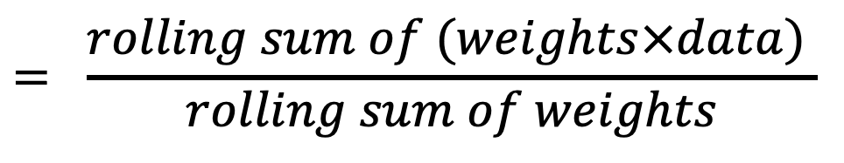
Example 2: Rolling weighted average through time
$$= \frac{rolling sum of (weights×data) }{rolling sum of weights}$$
Weighted rolling average
Notes:
Yeah, okay, it’s not an oceanographic index per-say, but this should be transferrable

Slide 42
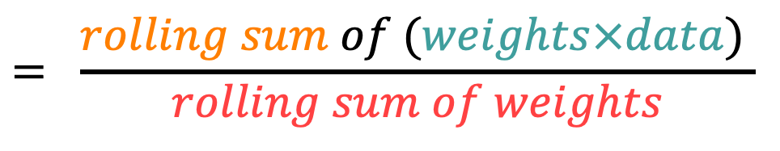
Example 2: Rolling weighted average through time
$$= \frac{rolling sum of (weights×data) }{rolling sum of weights}$$
Weighted rolling average
1
2
Multiply data by weights
Find rolling sum
numerator = (weights*data).rolling({‘time’:3}).sum()
3
4
Find rolling sum of weights
Divide
numerator = (weights).rolling({‘time’:3}).sum()

Slide 43
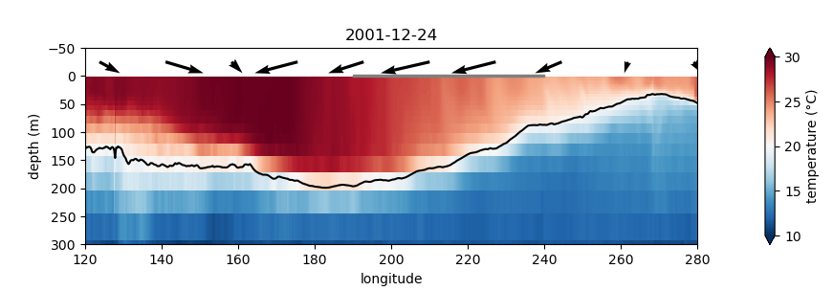

Example 3: 20° isotherm
Find that depth

Slide 44
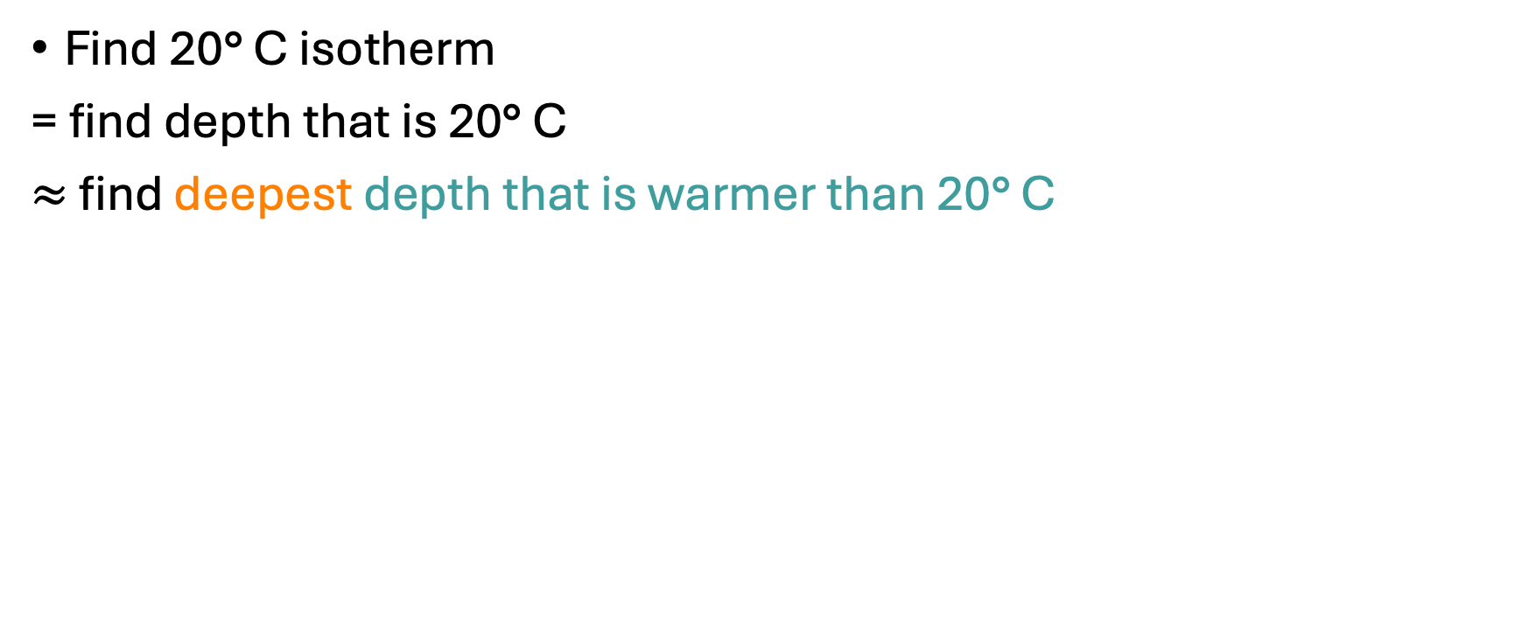

Example 3: 20° isotherm
Find 20° C isotherm
= find depth that is 20° C
$≈$ find deepest depth that is warmer than 20° C
1
Depth warmer than 20°C
warm_depth = depth.where(ds>20)
2
Deepest depth
warm_depth.argmax(“depth”)
or
warm_depth.idxmax(“depth”)

Slide 45
Example 4: analogue forecasts
Find the months of model output that look most similar to my target month

Slide 46
Example 4: analogue forecasts
Find the months of model output that look most similar to my target month
1
Calculate similarity (ie, mean squared error)
mse = ((all_sst-target_sst)**2).mean((‘lat’,’lon’))
2
Find the indices of lowest mean squared error
mse.idxmin(‘time’)
mse.argsort(‘time’).isel(time=slice(0,10))

Slide 47
Examples to talk through in groups
The windiest month ever in your birth town (using ERA5 global monthly zonal surface wind and meridional surface wind)
The odds of it raining tomorrow given it is raining today (using ERA5 global hourly precipitation rate )
The average temperature difference between days when it rains and days when it doesn’t (using ACCESS-ESM1-5 daily temperature and precipitation)
EXTENSION: The rate of global warming for coastal oceans (i.e. gridcells adjacent to the coast)

Slide 48
Hacks
If it fits in memory, use numpy arrays not dask arrays (though, test for your use case)
If it’s taking ages, manually break it into pieces and put them in a for loop
Save your intermediates
xr.apply_ufunc

Slide 49
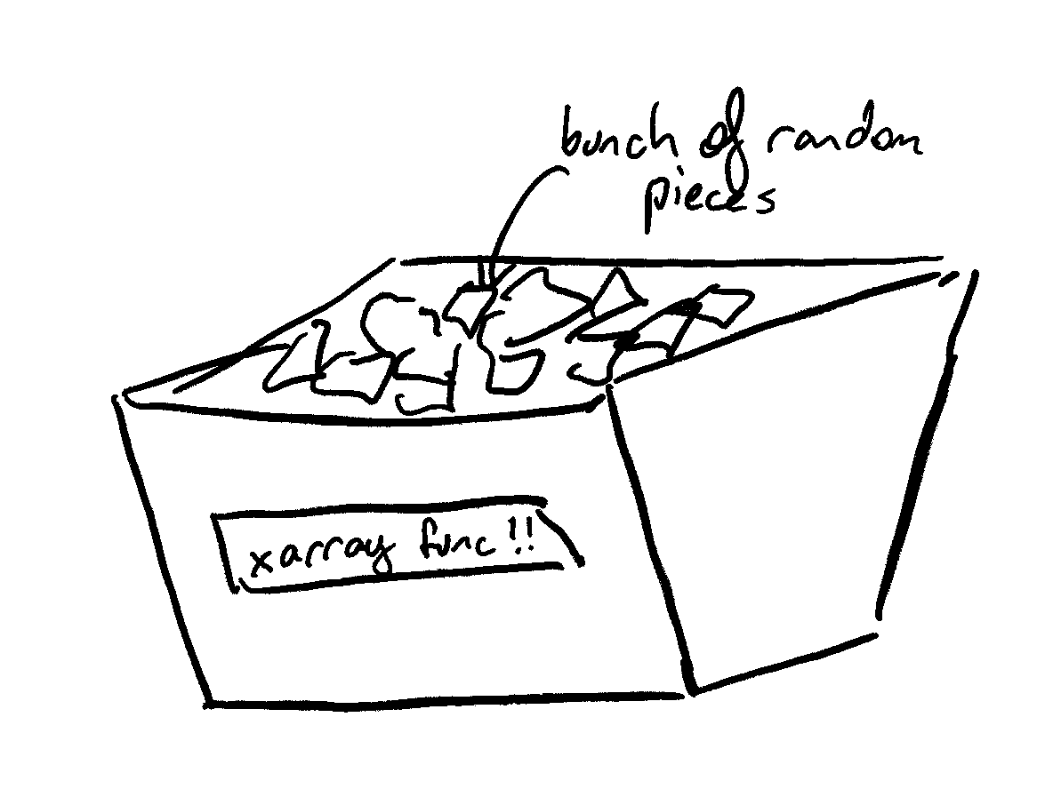

xr.apply_ufunc
Fig 1. My nice contained function
Fig 2. xarray
cosima-recipes/Tutorials/Apply_function_to_every_gridpoint.ipynb
https://tutorial.xarray.dev/advanced/apply_ufunc/apply_ufunc.html
Notes:
”in a trenchcoat”
In this instance, it’s even more important to be aware of chunking. I’ve been known to load data, and then chunk it, before applying this

Slide 50
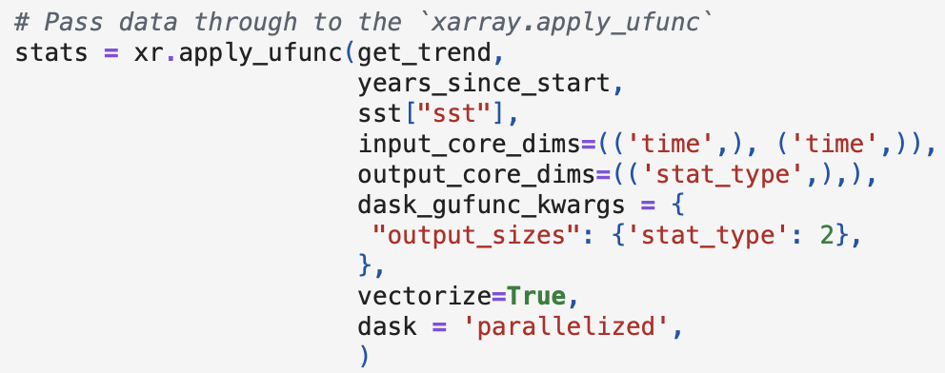
xr.apply_ufunc
cosima-recipes/Tutorials/Apply_function_to_every_gridpoint.ipynb
https://tutorial.xarray.dev/advanced/apply_ufunc/apply_ufunc.html
Notes:
”in a trenchcoat”
In this instance, it’s even more important to be aware of chunking. I’ve been known to load data, and then chunk it, before applying this

Slide 51
Code:
The windiest month ever in your birth town (using ERA5 global monthly zonal surface wind and meridional surface wind)
The odds of it raining tomorrow given it is raining today (using ERA5 global hourly precipitation rate )
The average temperature difference between days when it rains and days when it doesn’t (using ACCESS-ESM1-5 daily temperature and precipitation)
EXTENSION: The rate of global warming for coastal oceans (i.e. gridcells adjacent to the coast)

Slide 52
Reflecting on aims
To learn principles of good code, and get in the habit of thinking about what your code is doing
To understand vectorizing, xarray, and dask
To be able to:
Rewrite complicated ideas into vectorized code
Use dask to make this code run faster with less memory
To further optimize dask code with a few key arguments and the structure of your algorithm

Slide 53

Training Day Feedback Survey
https://forms.office.com/r/s7vShHpb3h

Slide 54


How to ask for help on ACCESS-Hive Forum?
https://forum.access-hive.org.au/

Slide 55




Good luck
jemma.jeffree@anu.edu.au
@jemmajeffree on hive/github
Notes:
Always happy to answer questions

